Slide 1


Slide 2

Acuity STAR / Western Computer Science Collaboration - CS3307a
Author: Paul Malcomson
Date Created: September 2015

Slide 3

Session Goals
Acuity STAR introduction
Problem statement
Project requirements
Data introduction – subject areas
Communication strategy

Slide 4
About Schulich
The Schulich School of Medicine & Dentistry employs 1,800+ faculty members in clinical and basic medical sciences, dentistry, and Robarts Research Institute.
Clinical Faculty work throughout London and area hospitals

Slide 5
About Acuity STAR
STAR is an acronym for “Staff Tracking & Activity Reporting”
Capture and report on Clinical Faculty career activities
Custom developed Web based application
Produces CV (curriculum vitae) and promotion documents

Slide 6
About Acuity STAR
Over 1,500 users from 14 clinical departments
Faculty, Secretaries, department administration
Historical focus has been data entry for faculty
Interest in aggregate reporting grows each year

Slide 7
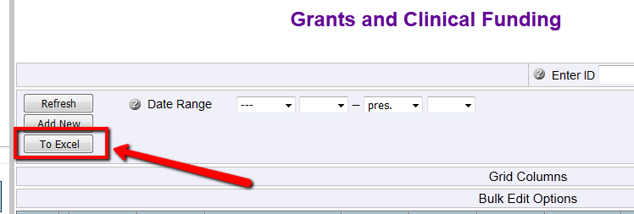
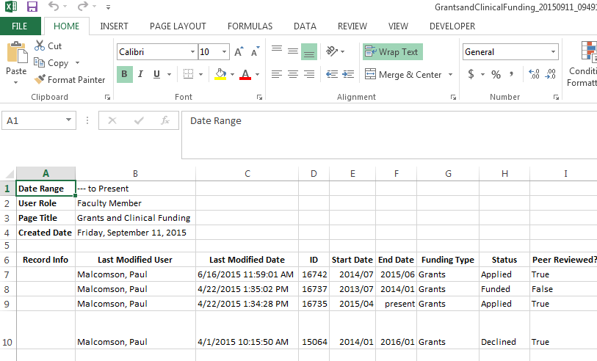
Problem Statement
Interest in analyzing and consuming aggregate data
STAR allows subject area export to Excel
Current Environment: manual data analysis based on user expertise

Slide 8
Problem Statement
How to automate this analysis?
Provide similar and consistent solution to each department

Slide 9
Project Requirements
Develop desktop application
Loads and processes ‘formatted’ Excel subject area data
Four (4) subject areas from STAR
Process lots of data (20,000+ rows)
Mandatory and ‘stretch’ requirements

Slide 10
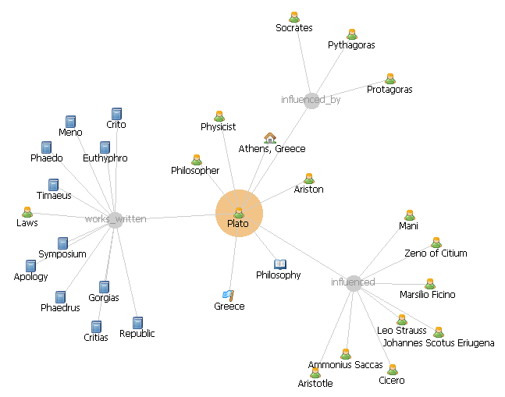
Project Requirements
Provide data analysis across faculty for a department (not cross departmental)
Summary info that is navigable and printable
Graphing and visualizations (maybe?)
Publication Summary
Department of Medicine
Date Range Selected:
2012-Jan | 2015-Dec
 |  |  |  | Total
+ | Publications |  |  | 200
 | + | Published Abstracts |  | 82
 |  |  | Filler, Guido | 17
 |  |  | Faculty name1 | 28
 |  |  | Faculty name2 | 4
 |  |  | Faculty name3 | 12
 |  |  | Faculty name4 | 10
 |  |  | Faculty name5 | 11
 | + | Journal Articles |  | 75
 | + | Books |  | 4
 | + | Book Chapters |  | 20
 | + | Letters to Editor |  | 19

Slide 11
Subject Areas
4 sections (screens) in STAR
Publications
Presentations
Grants & Clinical Funding
Teaching

Slide 12
Subject Areas
Data can have errors
Dates can be YYYY or YYYY/MM or YYYY/MM/DD
Dates, primary domain, member name must be present
Each subject area has other mandatory data
Optional data should be loaded but could be blank

Slide 13
Communication Strategy
Follow project schedule
Communication via email
Follow up in class
Paul Malcomson
paul.malcomson@sjhc.london.on.ca

Slide 14


